Slide 1


Sathish Kasinathan
09 August 2023

Slide 2

Outline
Executive Summary
Introduction
Methodology
Results
Conclusion
Appendix

Slide 3
Executive Summary
Summary of methodologies
Data Collection using web scraping and SpaceX API
Exploratory Data Analysis (EDA), including data wrangling, data visualization and interactive visual analytics
Machine Learning Prediction
Summary of all results
Data was to collected from public sources (Wikipedia) and provided API
EDA allowed to identify which features are the best to predict success of launchings
Machine Learning Prediction showed the best model to predict with the important characteristics to drive this opportunity with the best way with the help of collected data.

Slide 4
Introduction
Project background and context
Project background is to evaluate the viability of the new company Space Y to compete with Space X
Problems you want to find answers
Best way to find the estimate of total cost for launches, by predicting successful landings of the first stage of rockets
Find the best place to make launches.

Slide 5

Section 1

Slide 6
Methodology
Executive Summary
Data collection methodology:
Data was collected from SpaceX API (https://api.spacexdata.com/v4/rockets/)and Wikipedia(https://en.wikipedia.org/wiki/List_of_Falcon/_9/_and_Falcon_Heavy_launches) using web scrapping
Perform data wrangling
Data was collected, Then creating a landing outcome label based on outcome data after summarizing and analyzing of features
Perform exploratory data analysis (EDA) using visualization and SQL
Perform interactive visual analytics using Folium and Plotly Dash

Slide 7
Methodology
Executive Summary
Perform predictive analysis using classification models
Data was normalized and divided into training and test data sets then evaluated by four different classification models, being the accuracy of each model evaluated using different combinations of parameters

Slide 8
Data Collection
Describe how data sets were collected.
Data was collected from SpaceX API (https://api.spacexdata.com/v4/rockets/)and Wikipedia(https://en.wikipedia.org/wiki/List_of_Falcon/_9/_and_Falcon_Heavy_launches) using web scrapping
You need to present your data collection process use key phrases and flowcharts

Slide 9
Data Collection – SpaceX API
Data was obtained using SpaceX API and created the Data Frame
Falcon 9 Launches was filtered
Handles the missing values
Data Collected using API
Request API and parse the SpaceX launch data
Falcon 9 Launches data was filtered
Handle the missing values

Slide 10
Data Collection - Scraping
SpaceX data was collected using web scrapping
Parse the Table from the web scrapped data
Extracted the HTML Data and created Data Frame
Data Collected using Web Scrapping
Request Falcon 9 Launch of Wiki Page and processed the web scrapping
Parsed the HTML Tables
from the Scrapped Data
Created the Data Frame from the extracted HTML Table

Slide 11
Data Wrangling
Exploratory Data Analysis (EDA) was performed on the dataset.
Summarization of launches per site, occurrences of each orbit and occurrences of mission outcome per orbit type were calculated.
Landing outcome label was created from Outcome column.
Data Wrangling
Exploratory Data Analysis
Summarization of Data
Create Landing outcome label

Slide 12
EDA with Data Visualization
Scatterplots and Bar plots were used to visualize the relationship between pair of features
Payload Mass vs Flight Number
Launch Site vs Flight Number
Launch Site vs Payload Mass
Orbit vs Flight Number
Payload vs Orbit

Slide 13
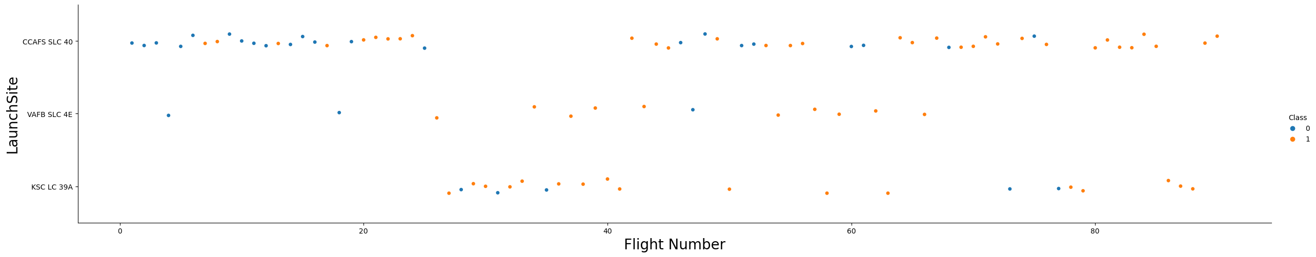
EDA with Data Visualization(Continued.)

Slide 14
EDA with SQL
Following SQL queries were performed
Names of the unique launch sites in the space mission
Top 5 launch sites whose name begin with the string 'CCA'
Total payload mass carried by boosters launched by NASA (CRS)
Average payload mass carried by booster version F9 v1.1
Date when the first successful landing outcome in ground pad was achieved
Names of the boosters which have success in drone ship and have payload mass between 4000 and 6000 kg
Total number of successful and failure mission outcomes

Slide 15
EDA with SQL
Following SQL queries were performed (Continued.)
Names of the booster versions which have carried the maximum payload mass
Failed landing outcomes in drone ship, their booster versions, and launch site names for in year 2015
Rank of the count of landing outcomes (such as Failure (drone ship) or Success (ground pad)) between the date 2010 06 04 and 2017 03 20
EDA with SQL

Slide 16
Build an Interactive Map with Folium
Following were used with Folium Maps
Markers - It indicate points like launch sites
Circles - It indicate highlighted areas around specific coordinates, like NASA Johnson Space Center
Marker clusters - It indicates groups of events in each coordinate, like launches in a launch site
Lines - It indicates distances between two coordinates
Interactive map with Folium map

Slide 17
Build a Dashboard with Plotly Dash
Following graphs and plots were used to visualize data•
Percentage of launches by site
Payload range
Above combination helped to analyze the relation between payloads and launch sites, also helped to identify the best place to launch according to payloads.
Plotly Dash lab

Slide 18
Predictive Analysis (Classification)
Following classification models were compared
Logistic regression
Support vector machine
Decision tree
K nearest neighbors
Predictive analysis lab
Data Preparation & Standardization
Test each models with combinations of hyperparameters
Comparison of results

Slide 19
Results
Exploratory data analysis results
Space X uses 4 different launch sites;
The first launches were done to Space X itself and NASA;
The average payload of F9 v1.1 booster is 2,928 kg;
The first success landing outcome happened in 2015 fiver year after the first launch;
Many Falcon 9 booster versions were successful at landing in drone ships having payload above the average;
Almost 100% of mission outcomes were successful;
Two booster versions failed at landing in drone ships in 2015: F9 v1.1 B1012 and F9 v1.1 B1015;
The number of landing outcomes became as better as years passed.

Slide 20
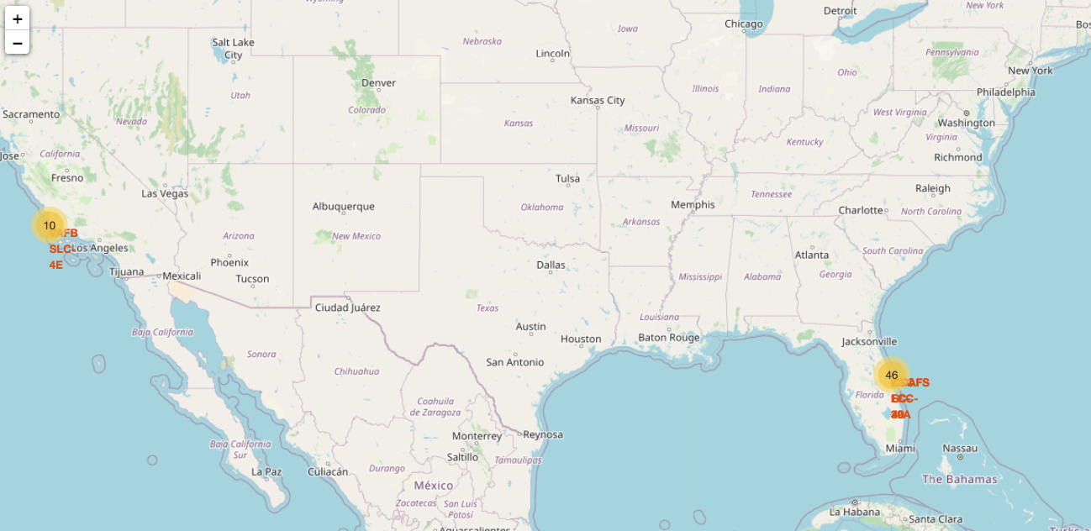
Results
Using interactive analytics was possible to identify that launch sites use to be in safety places, near sea, for example and have a good logistic infrastructure around.
Most launches happens at east cost launch sites. Interactive analytics demo in screenshots

Slide 21
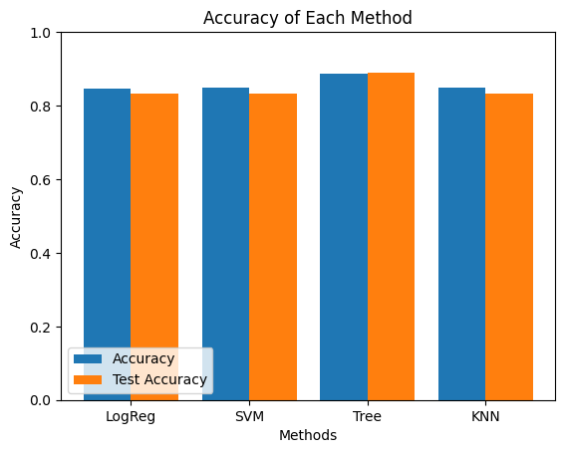
Results
Predictive Analysis showed that Decision Tree Classifier is the best model to predict successful landings, having accuracy over 87% and accuracy for test data over 94

Slide 22

Section 2

Slide 23
Flight Number vs. Launch Site
According to the below plot, it’s possible to verify that the best launch site nowadays is CCAF5 SLC 40, where most of recent launches were successful
In second place VAFB SLC 4E and third place KSC LC 39A
It’s also possible to see that the general success rate improved over time

Slide 24
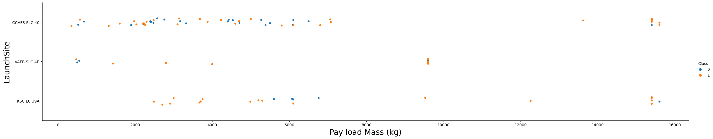
Payload vs. Launch Site
Payloads over 9,000kg (about the weight of a school bus) have excellent success rate
Payloads over 12,000kg seems to be possible only on CCAFS SLC 40 and KSC LC 39A launch sites

Slide 25
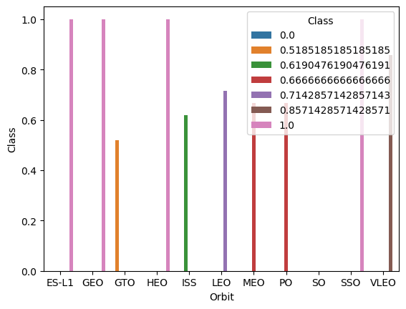
Success Rate vs. Orbit Type
The Most success rates happens to orbits
ES L1
GEO
HEO
SSO

Slide 26
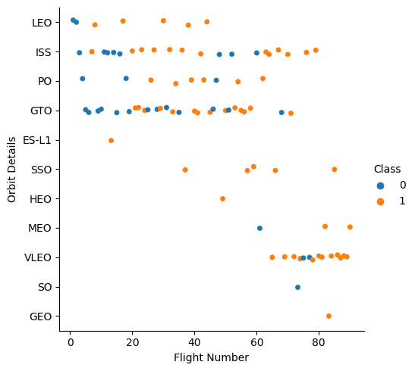
Flight Number vs. Orbit Type
Success rate improved over time to all orbits
VLEO orbit seems a new business opportunity, due to recent increase of its frequency

Slide 27
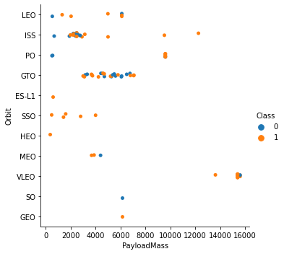
Payload vs. Orbit Type
There is no relation between payload and success rate to orbit GTO
ISS orbit has the widest range of payload and a good rate of success
There are few launches to the orbits SO and GEO.

Slide 28
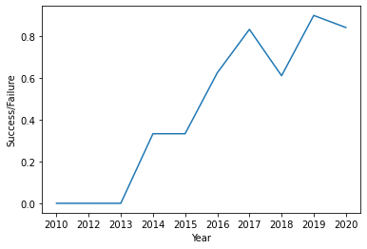
Launch Success Yearly Trend
Success rate started increasing in 2013 and kept until 2020
It seems that the first three years were a period of adjusts and improvement of technology

Slide 29
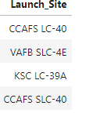
All Launch Site Names
They are obtained by selecting unique occurrences of Launch site values from the dataset.

Slide 30
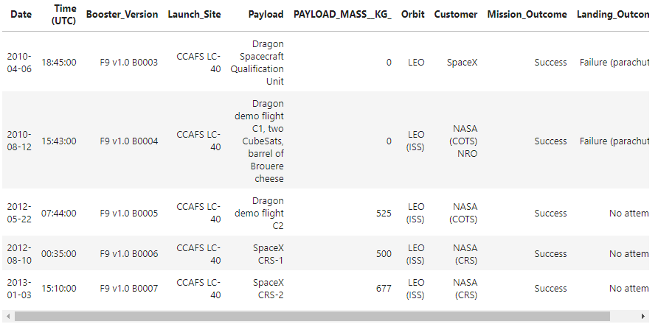
Launch Site Names Begin with 'CCA'
5 records where launch sites begin with `CCA`

Slide 31
Total Payload Mass
Total payload carried by boosters from NASA
Used Sum function to find the total payload
Total Payload(kg)
111.268

Slide 32
Average Payload Mass by F9 v1.1
Average payload mass carried by booster version F9 v1.1
Used AVG function to find the average payload mass carried by booster version F9 v1.1
Average payload mass
2.928 KG

Slide 33
First Successful Ground Landing Date
First successful landing outcome on ground pad
Used Min function to identify the dates of the first successful landing outcome on ground pad
Min Date
2015-12-22

Slide 34
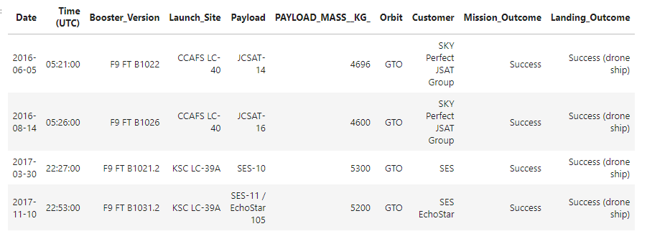
Successful Drone Ship Landing with Payload between 4000 and 6000
List the names of boosters which have successfully landed on drone ship and had payload mass greater than 4000 but less than 6000
Used Between keyword to filter the payload mass from 4000 to 6000

Slide 35
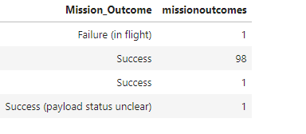
Total Number of Successful and Failure Mission Outcomes
Calculate the total number of successful and failure mission outcomes
Used Groupby feature to calculate the successful and failure mission outcomes

Slide 36
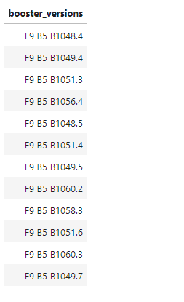
Boosters Carried Maximum Payload
Names of the booster which have carried the maximum payload mass.
Used subquery to identify the booster which have carried the maximum payload mass

Slide 37
2015 Launch Records
Failed landing outcomes in drone ship, their booster versions, and launch site names for in year 2015
Booster Version | Launch Site
F9 v1.1 B1012 | CCAFS LC 40
F9 v1.1 B1015 | CCAFS LC 40

Slide 38
Rank Landing Outcomes Between 2010-06-04 and 2017-03-20
Ranking of all landing outcomes between the date 2010-06-04 and 2017-03- 20
Landing Outcome | Occurrences
No attempt | 10
Failure(drone ship) | 5
Success(drone ship) | 5
Controlled(ocean) | 3
Success(ground pad) | 3
Failure(parachute) | 2
Uncontrolled(ocean) | 2
Precluded(drone ship) | 1

Slide 39

Section 3

Slide 40
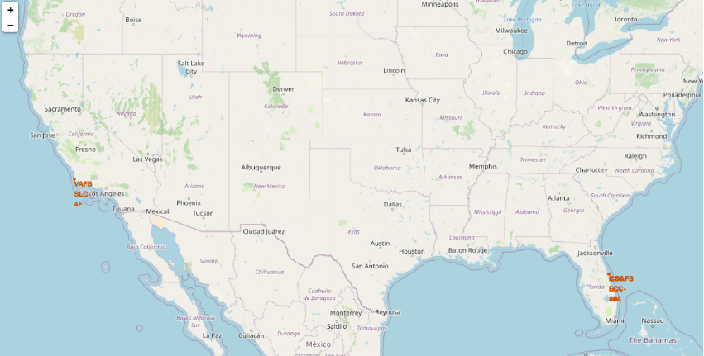
Launch Sites
Launch sites are near sea, probably by safety, but not too far from roads and railroads.

Slide 41
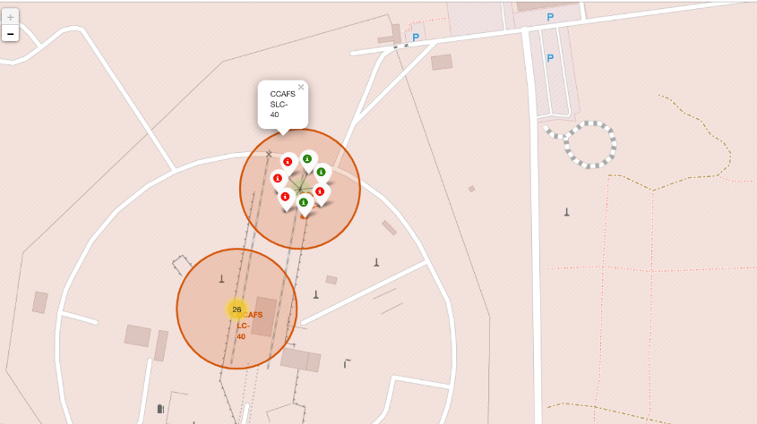
Launch Outcomes by Site
Example of CCFAS SLC-40 launch site launch outcomes
Green markers indicate successful and red ones indicate failure.

Slide 42

Logistics and Safety
Launch site KSC LC-39A has good logistics aspects, being near railroad and road and relatively far from inhabited areas.

Slide 43

Section 4

Slide 44
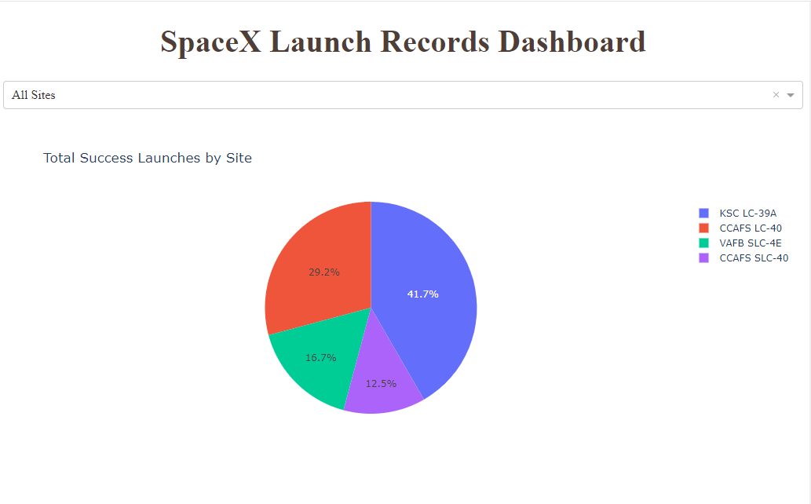
Space X Launches
The place from where launches are done seems to be a very important factor of success of missions.

Slide 45
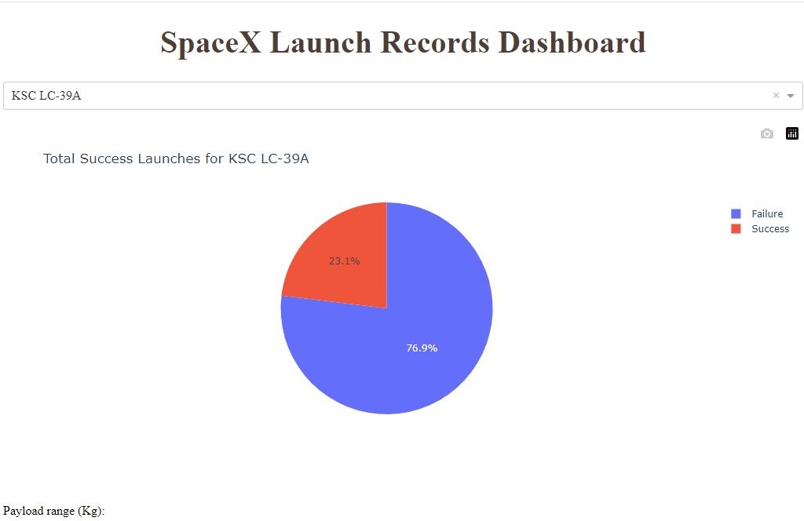
Success Ratio of KSC LC-39A Launch
76.9% of launches are successful in this site.

Slide 46
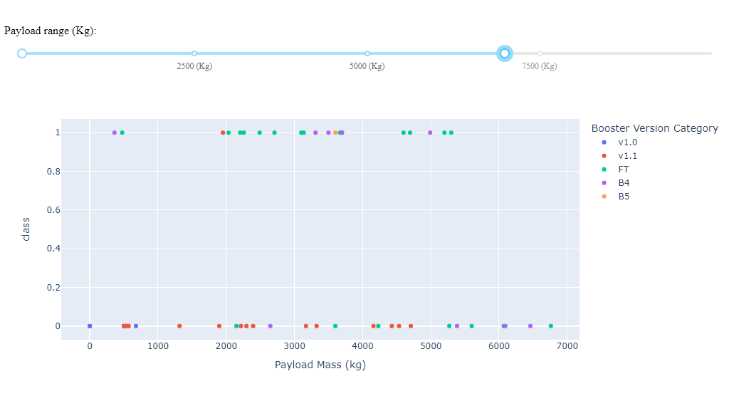
Payload vs Launch Outcome
Payloads under 6,000kg and FT boosters are the most successful combination.

Slide 47

Section 5

Slide 48
Classification Accuracy
Four classification models were tested, and their accuracies are plotted beside
The model with the highest classification accuracy is Decision Tree Classifier which has accuracies over than 84%.

Slide 49

Confusion Matrix
Confusion matrix of Decision Tree Classifier proves its accuracy by showing the big

Slide 50
Conclusions
Different data sources were analyzed, refining conclusions along the process
The best launch site is KSC LC 39A
Launches above 7000kg are less risky
Although most of mission outcomes are successful, successful landing outcomes seem to improve over time, according the evolution of processes and rockets
Decision Tree Classifier can be used to predict successful landings and increase profits

Slide 51
Appendix
Include any relevant assets like Python code snippets, SQL queries, charts, Notebook outputs, or data sets that you may have created during this project

Slide 52


